Slide 1




Development of a Kinect driver under ROS2
Presented by :
MARTELET Curtis
EL-HAGE Andrew
Supervised by :
Ms. LI Wanchen
In collaboration with the LIRMM Laboratory

Slide 2
Presentation Plan
Introduction
What is the Kinect v2
ROS 1 vs ROS 2
What are IAI and Libfreenect2
Calibration of the Kinect
Video recording function
Problems encountered during the project
Conclusion

Slide 3
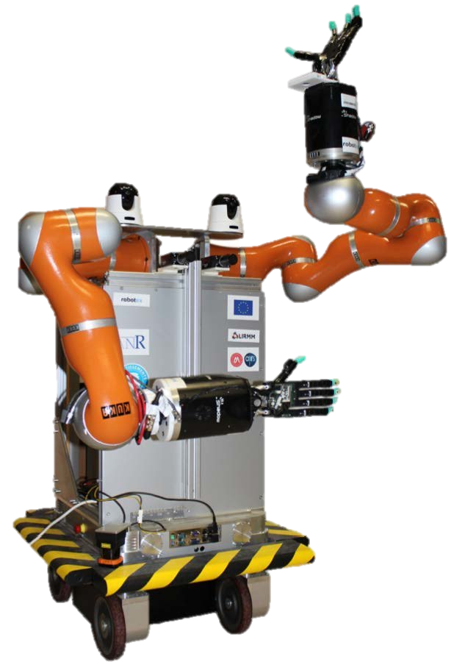
1. Introduction
Objectives
Develop a Kinect driver in C++ language (calibration and recording)
Familiarize with Kinect usage
Understanding the differences between ROS 1 and ROS 2
Understanding the advantages and disadvantages of this type of camera
Final Application
Bimanual Agile Zany Anthropomorphic Robot - BAZAR

Slide 4
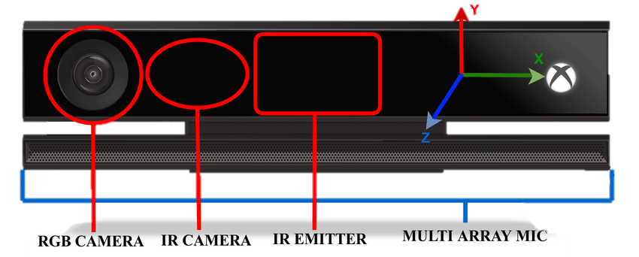
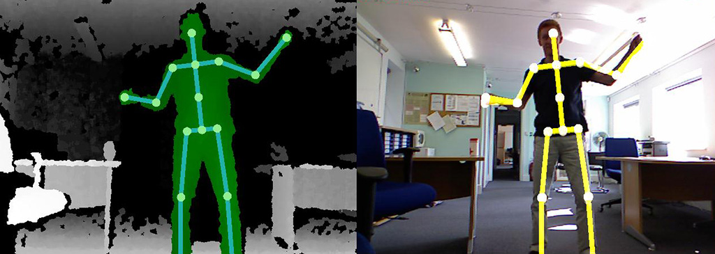
2. What is the Kinect v2
RGBD camera device - produced by Microsoft

Slide 5
3. ROS 1 vs ROS 2
Aspect | ROS 1 | ROS 2
Language Support | C++ - Python 2 | C++ - Python 3
Supported OS | Linux - MAC | Linux - MAC - Windows
Real-Time Capability | Not designed for real-time applications | Can be used for real-time performance
Multi-Robot Systems | Limited native support | Better support for multi-robot setups
Security | Not designed for high-security apps | Provides some security features

Slide 6
4. What are IAI and Libfreenect2
IAI
iai_kinect2 is a collection of tools and libraries for a ROS interface with the Kinect 2 camera.
Functionalities it contains:
Calibration tool (kinect2_calibration)
Depth registration library (kinect2_registration)
Bridge between libfreenect2 and ROS (kinect2_bridge)
Image and point cloud viewer (kinect2_viewer)
Libfreenect2
An open-source driver for the Kinect v2.
It provides support for RGB and depth images.

Slide 7
5. Calibration of the Kinect

Slide 8
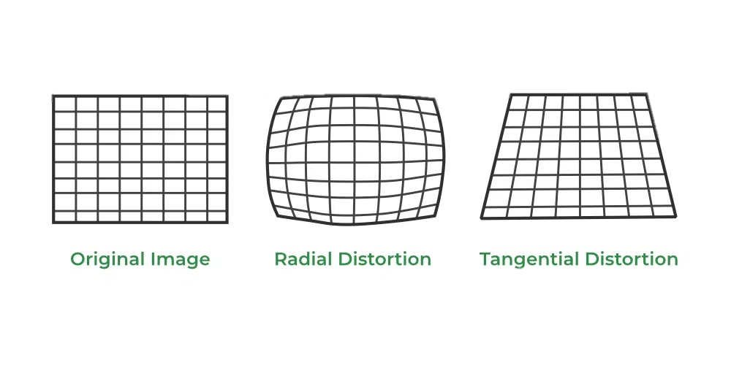
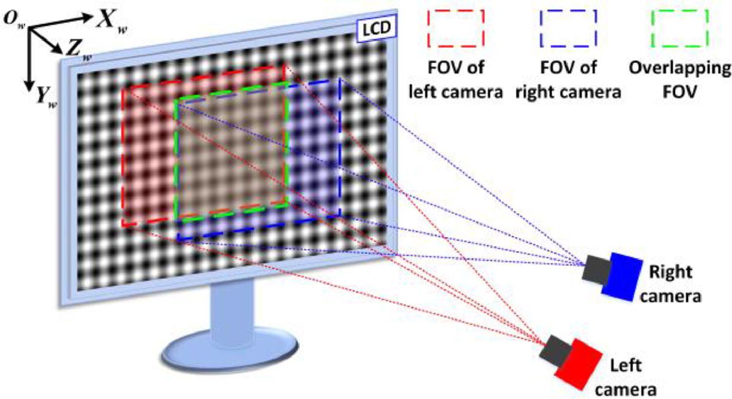
5. Calibration of the Kinect
Mono Calibration
To compensate for errors caused by distortions
Stereo Calibration
To centralize the points of view of the two cameras

Slide 9

5. Calibration of the Kinect₍₂₎
What is OPEN CV ?
OpenCV is an open-source computer vision library designed for real-time computer vision tasks.
Open CV Output
The camera matrix (the intrinsic parameters of the camera)
The Distortion Coefficients
The rotation matrix (the rotation of the camera for each calibration image)
The projection matrix (the translation of the camera for each calibration image)

Slide 10
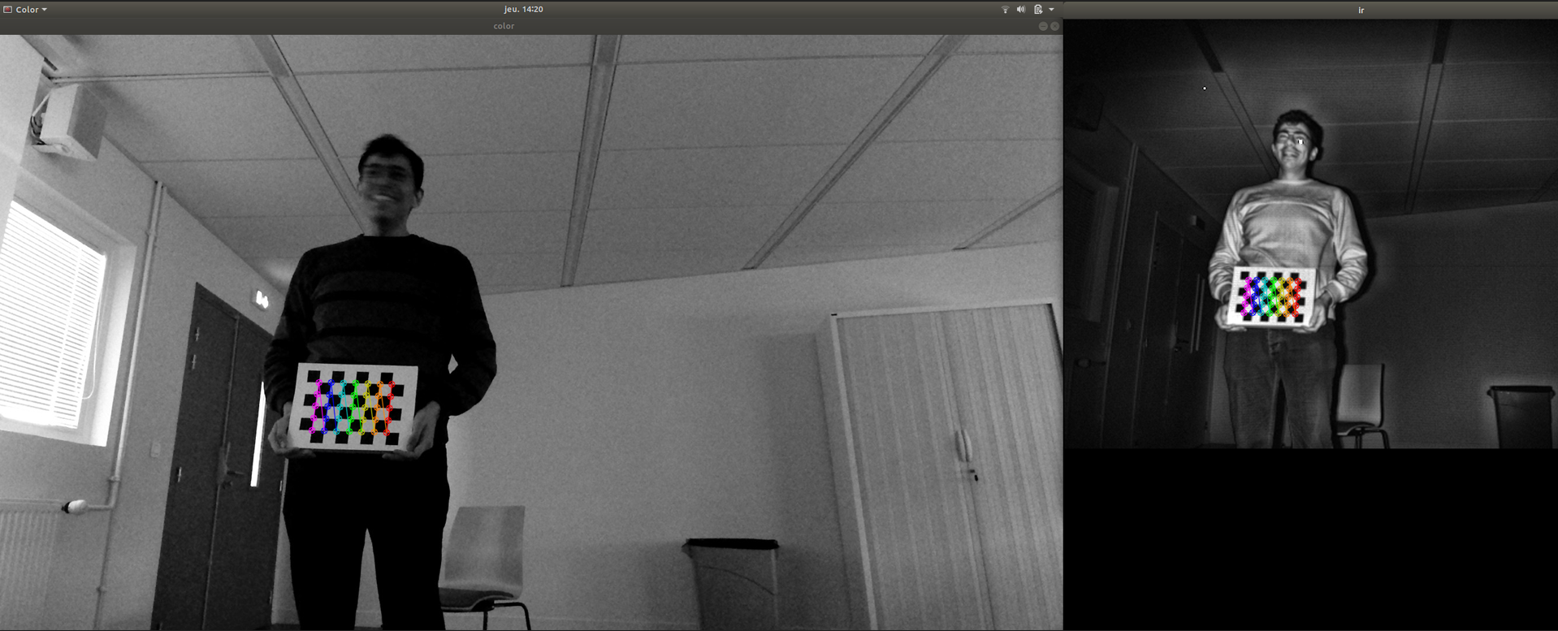
5. Calibration of the Kinect₍₃₎
How to calibrate using OpenCV
Notes:
XML dans bridge

Slide 11
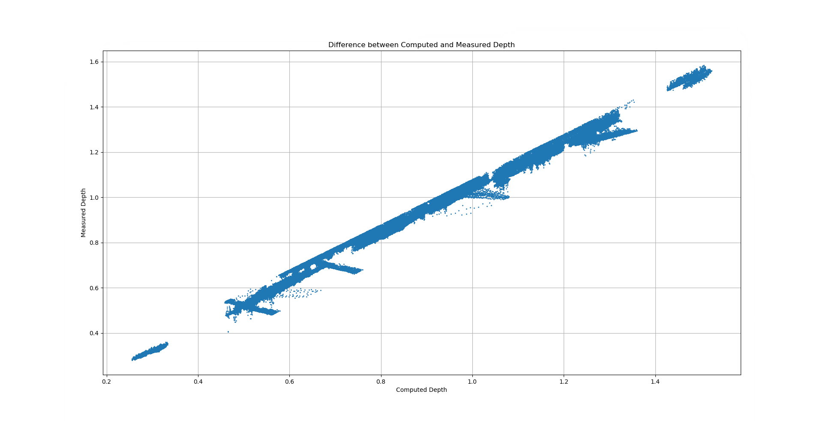
5. Calibration of the Kinect₍₄₎
Calibration Results

Slide 12
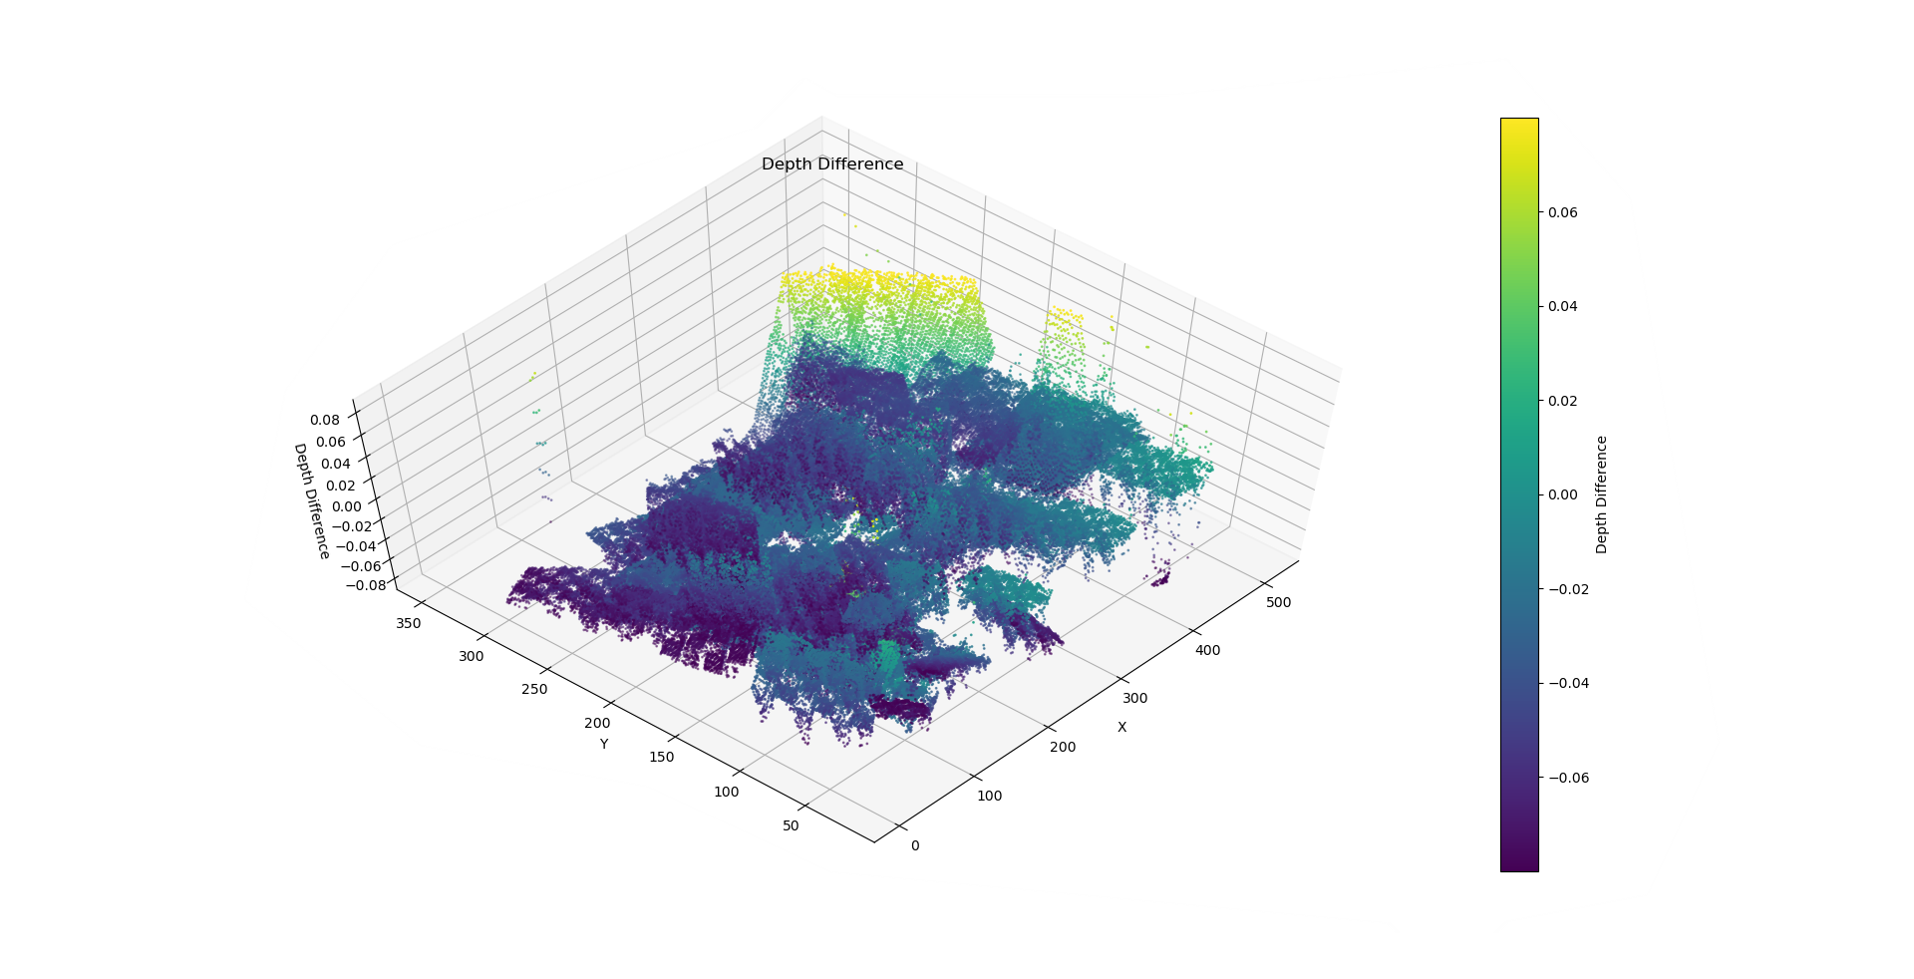
5. Calibration of the Kinect₍₅₎
Calibration Results₍₂₎

Slide 13
6. Video recording function

Slide 14
6. Record Function₍₁₎
Introduction
KINECT
Kinect2_Record
Color video
Color video
Depth informations flux
Depth video
Synchronized videos
Synchronized Video
Capture frequency | Capture duration | Output format

Slide 15
6. Record Function₍₂₎
Diagram of the kinect2_record node
Time Limit
Reached
Image from topics
No
Save image
Yes
Done at the specified rate
Image Processing
Output video

Slide 16
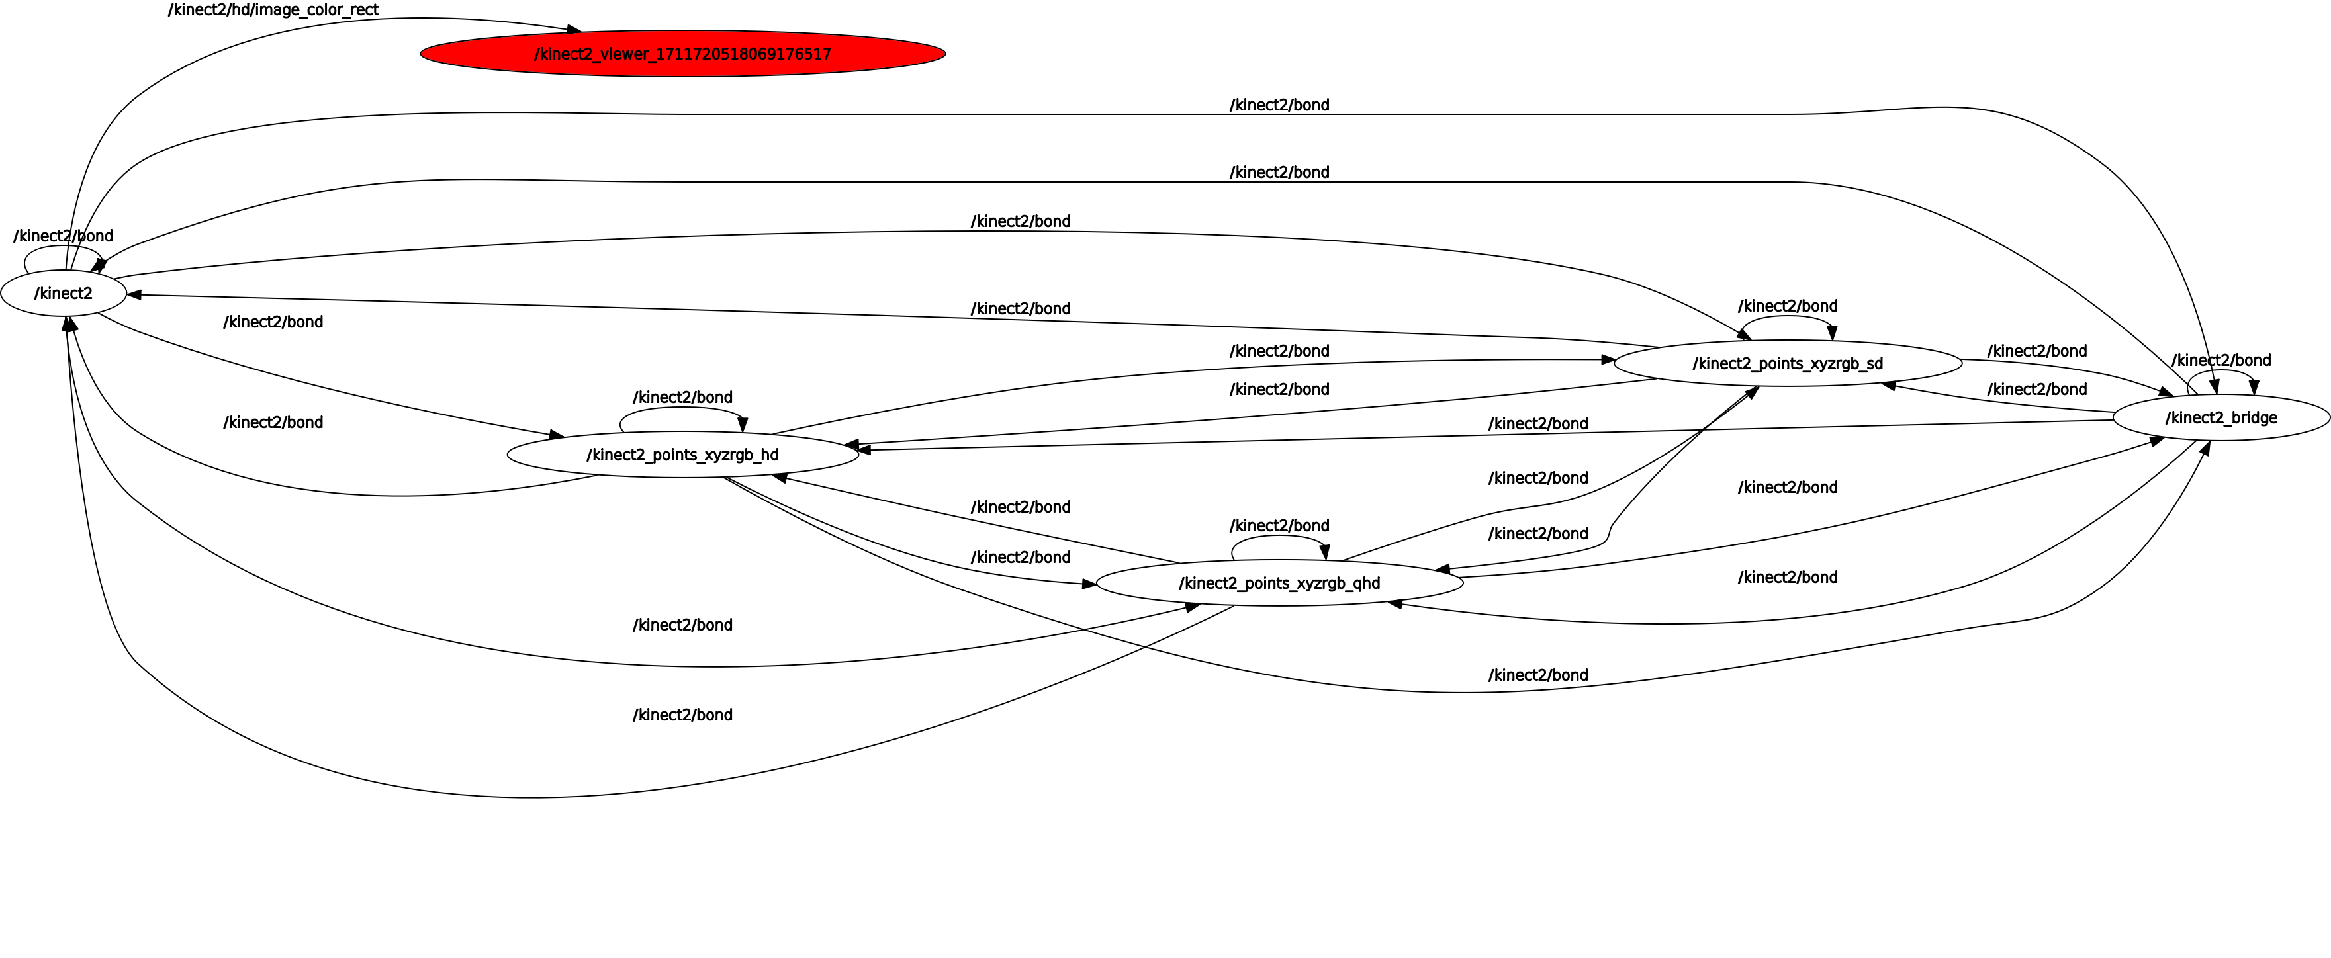
6. Record Function₍₃₎
Graph of the viewer node

Slide 17
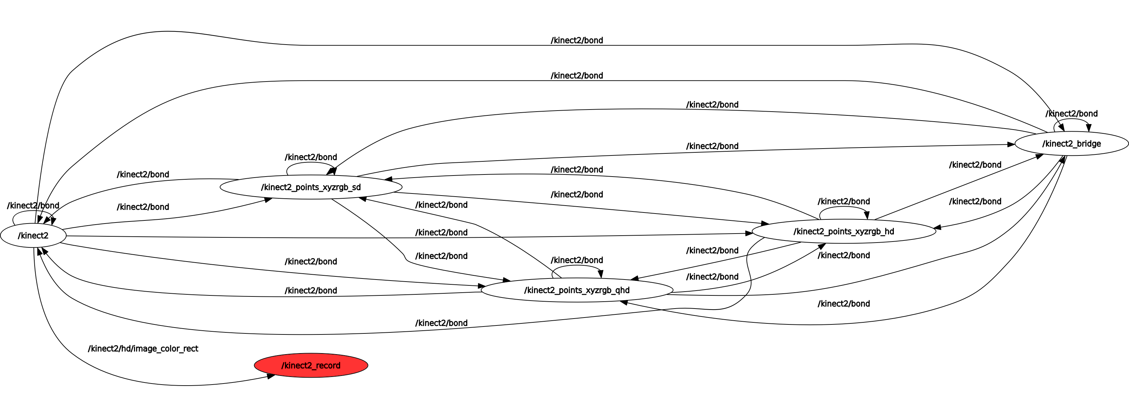
6. Record Function₍₄₎
Graph of the record node

Slide 18
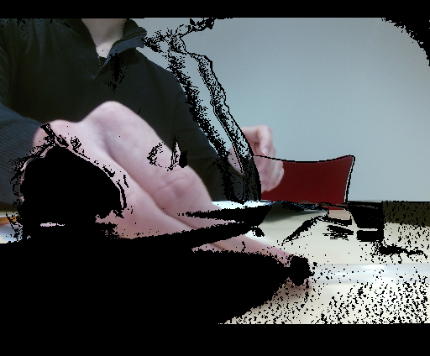

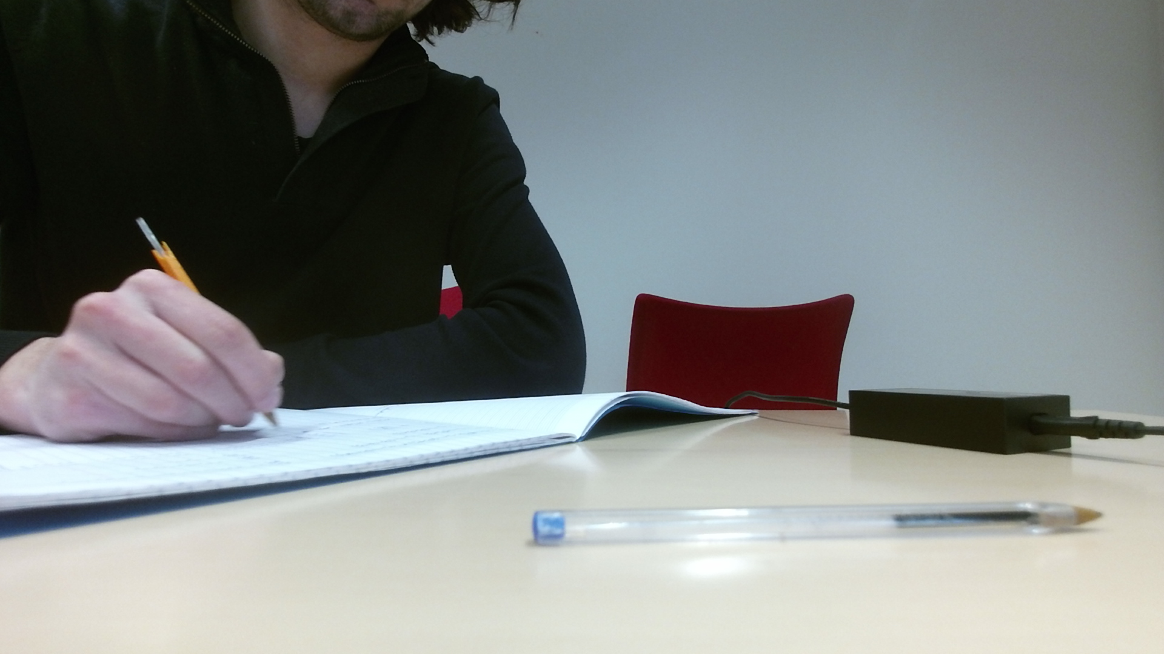
6. Record Function₍₅₎
Topics
Sync
Topic : /kinect2/hd/image_depth_rect
Resolution : 512x424
Type : BGR8
Depth
Topic : /kinect2/hd/image_depth_rect
Resolution : 1920x1080
Format : TYPE_16UC1
Color
Topic : /kinect2/hd/image_depth_rect
Resolution : 1920x1080
Type : BGR8

Slide 19
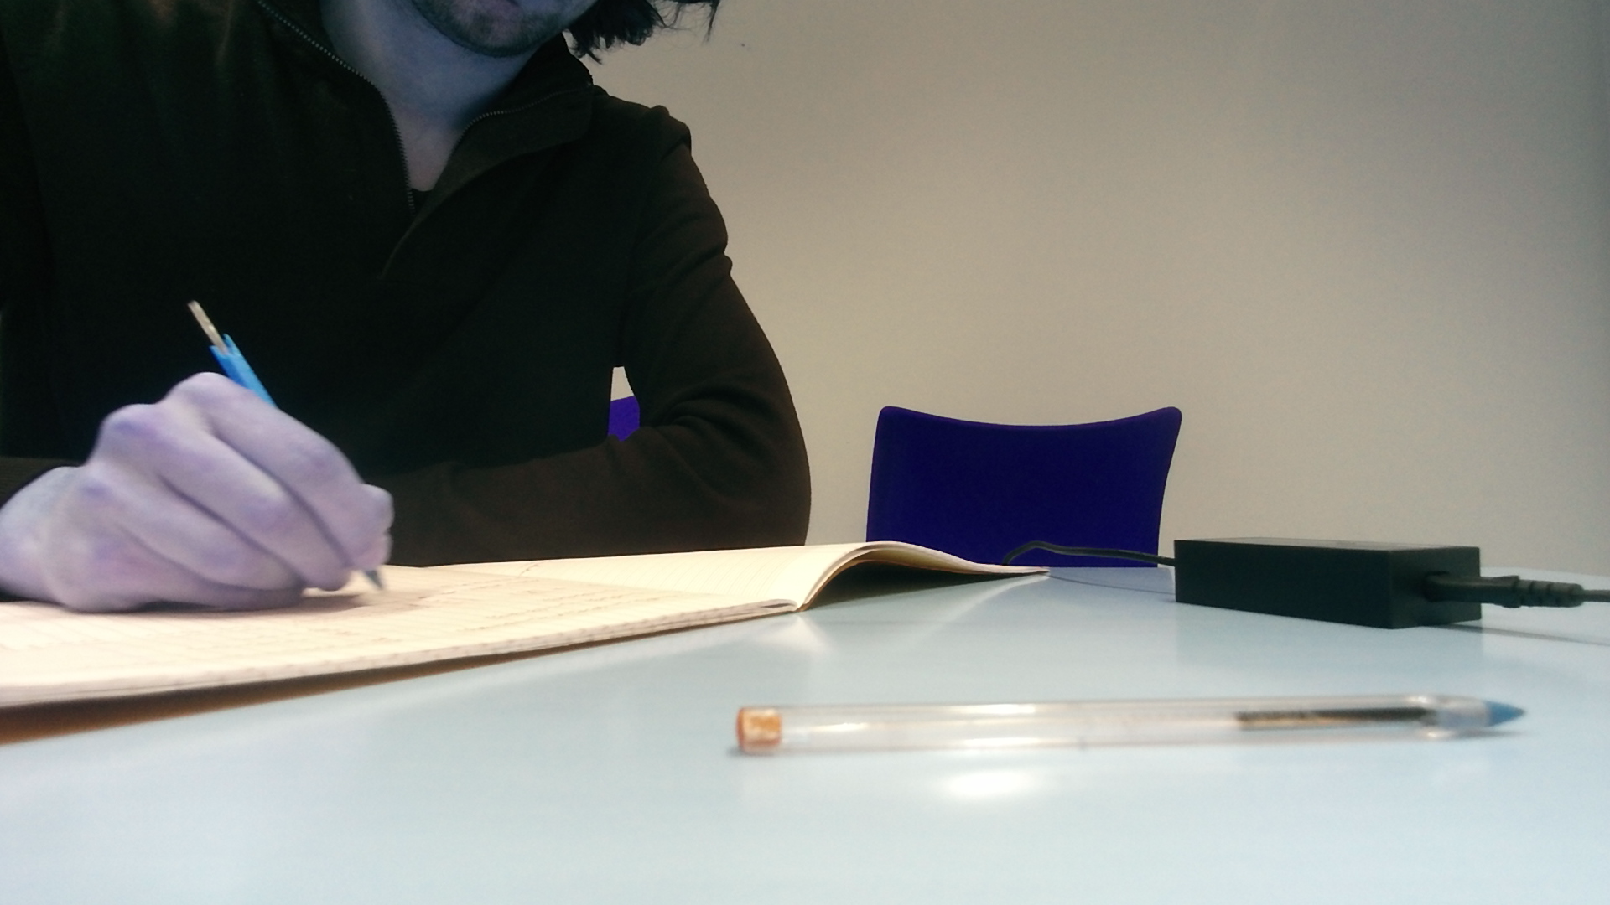
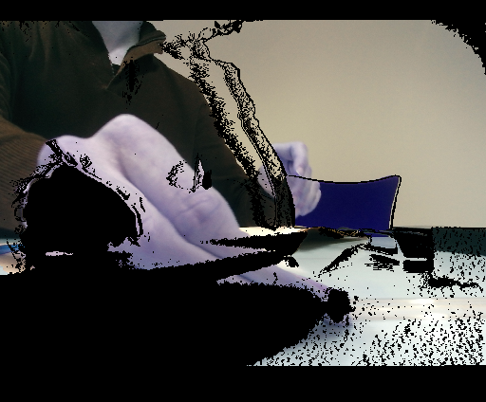
6. Record Function₍₆₎
Correct Channels Function
BGR
RGB

Slide 20
6. Record Function₍₇₎
Video Writer
We use OpenCV to make the videos :
cv::VideoWriter video_writer(<output name + extension>, <FOURCC>, <fps>, <image size>)
output name + extension : name of the output file with its extension.
FOURCC : sequence of four bytes identifier used to specify the video codec.
fps : specifies the frame rate of the output video.
image size : specifies the size of each frame in the output video
String
Identifier
Float
cv::Size

Slide 21
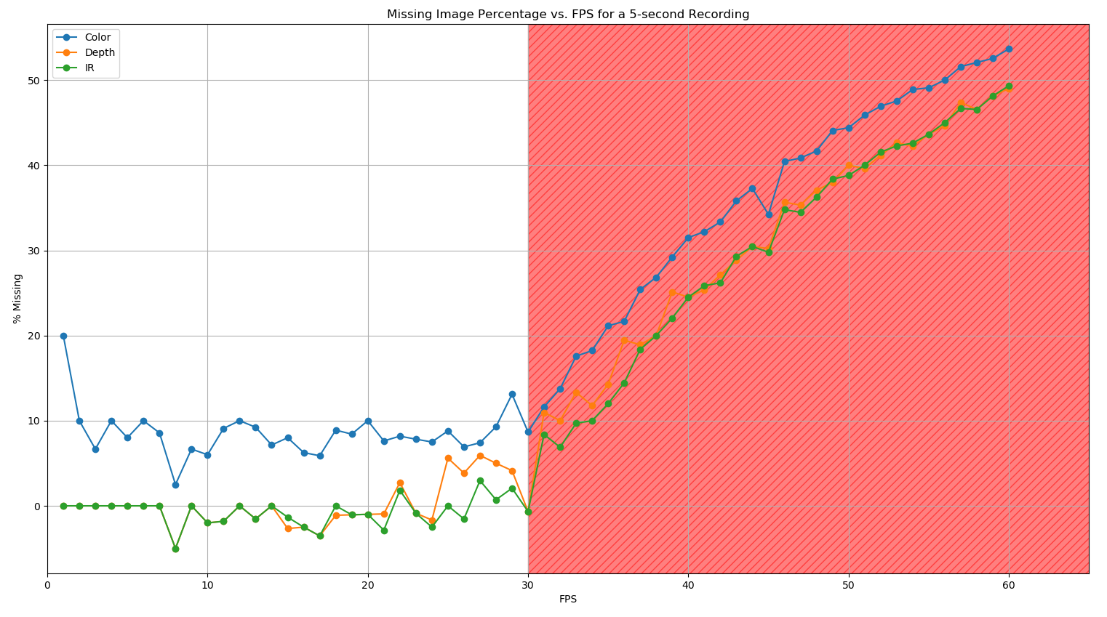
6. Record Function₍₈₎
Performance test

Slide 22
7. Problems encountered during the project
The Kinectv2 isn’t compatible with USB 4.0 port. It only support USB 3.0 to 3.2.
Libfreenect2 isn’t compatible with ROS2. This meant we couldn’t do the project with ROS2.
Iai uses OpenCV 2.0 for its vision tasks. This version is no longer available through package managers (apt or snap).
OpenCV can’t write gifs.

Slide 23



8. Conclusion
Results :
The camera is calibrated.
Even if it is not with ROS2, we managed to record the cameras through ROS interface. Moreover, the performance is better than expected.
RGB Video
Depth Video
Synchronized Video
Amelioration :
Re-write IAI with a driver compatible with ROS2.
Recognize QR code in real time.

